Slide 1

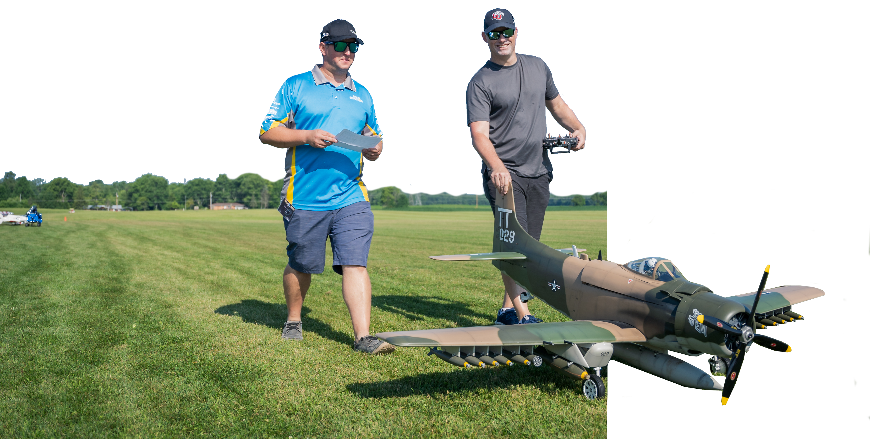
Model Aviation
Fun, Fellowship and Passion

Slide 2
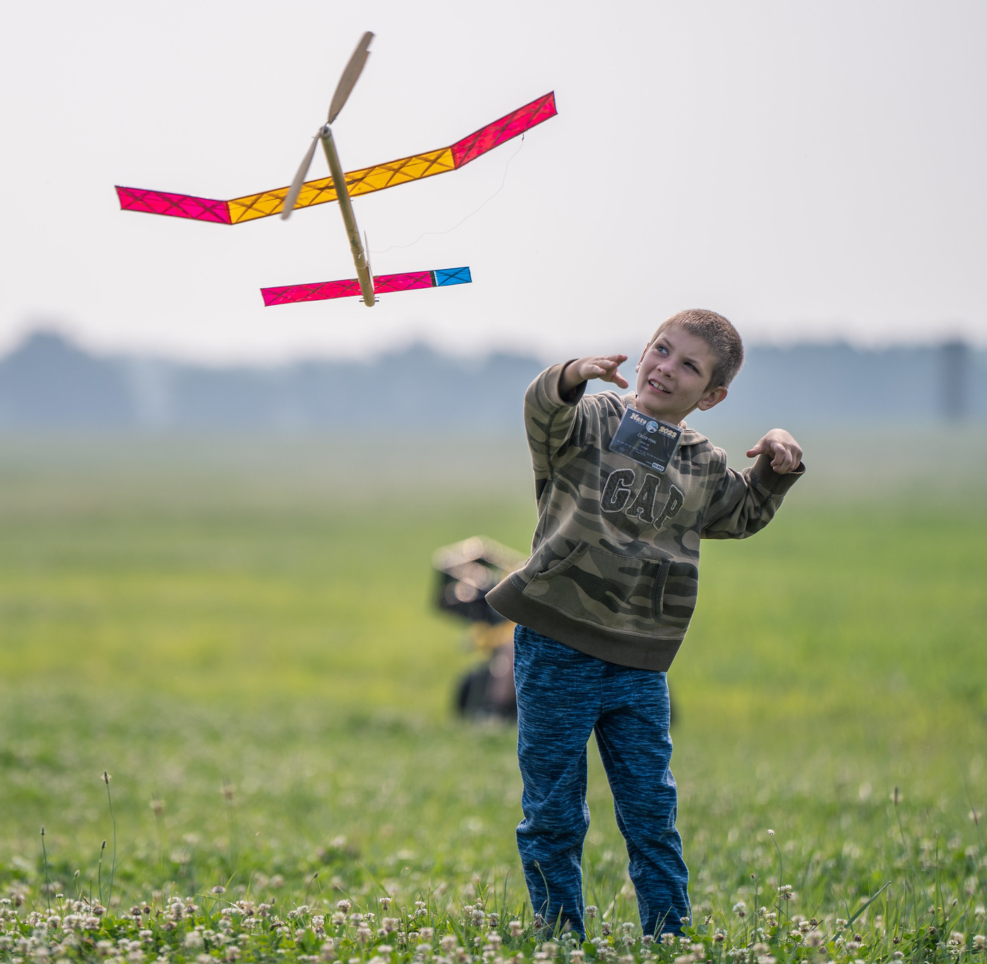
Model Aviation
Model Aviation is a challenging and rewarding hobby that combines achievement, fulfillment and growth by offering a unique blend of fun, fellowship, and lifelong learning.
Ignites a passion for aviation and science, technology, engineering, arts, and mathematics (STE(A)M) providing a foundation for success in school and careers.
Hone a variety of skills, including problem-solving, patience, concentration, and attention to detail, all while having fun and of course creating something that actually flies! Every project completed within this hobby offers a tangible sense of achievement, challenging participants in the best way possible.
Model Aviation enthusiasts are community and family oriented as the hobby brings people of all ages and walks of life together, regardless of background or physical ability.
Be part of a legacy that is here to stay, with connections to notable figures and a rich history that continues to inspire.
Come Fly With Us!

Slide 3
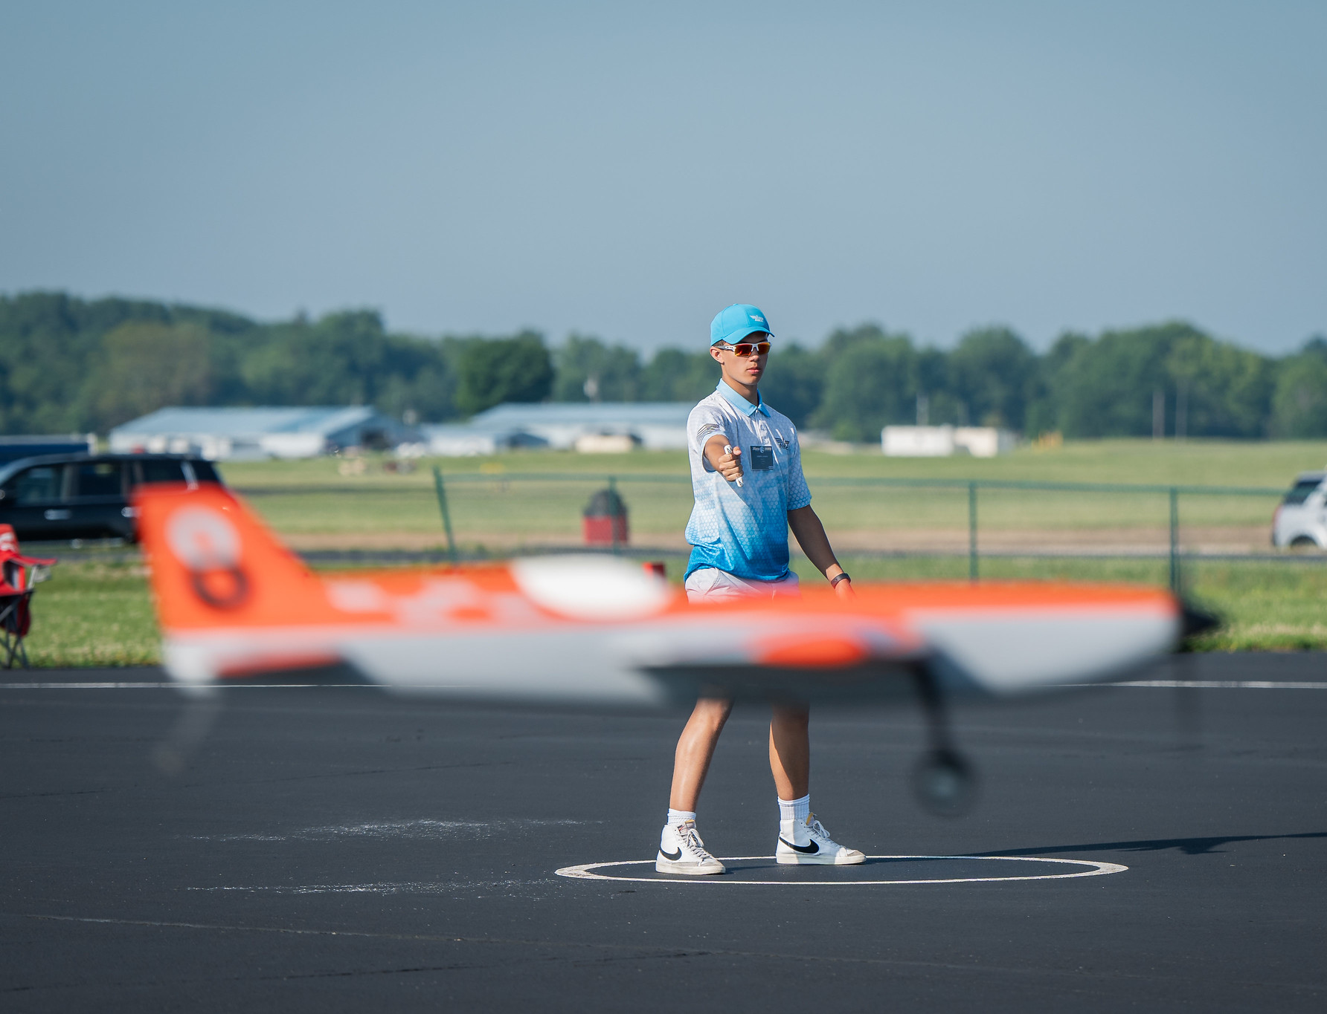
Academy of Model Aeronautics
The Academy of Model Aeronautics (AMA), is a nonprofit community of enthusiasts who come together to celebrate model aviation.
We are hobbyists who dream, design, build, and fly model aircraft of all sizes for fun and competition.
At the AMA we are dedicated to protecting and promoting the hobby as the national and global voice for model aviation enthusiasts, offering advocacy, credibility, and leadership that fosters a strong unified community.
Our nationwide network of clubs supports this passion by providing flying fields, mutual learning, and a safe and fun environment for model aviation activities.
Our organization advocates every day for the safe enjoyment of model aviation.
AMA Members share a passion and have access to clubs and events nation wide! They stay connected with Model Aviation magazine, AMA Air, Newsletters, Social Media and more.
Come Fly With Us!

Slide 4
AMA Chartered Club
Club Logo
<insert details about your local club>
Come Fly With Us!

Slide 5
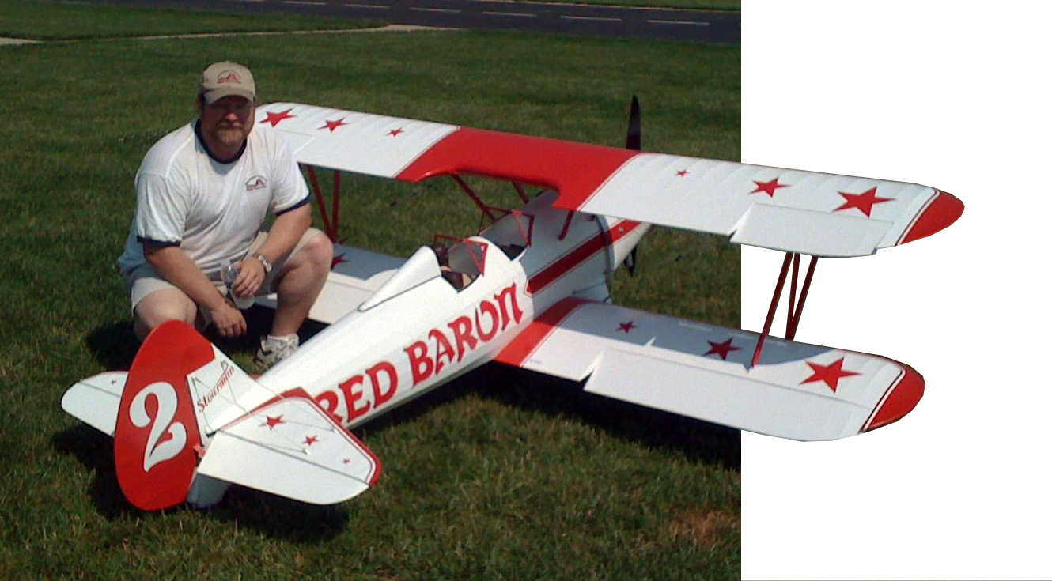
Model Aviation – Come Fly with Us!
Thank You for your time and attention

