Slide 1
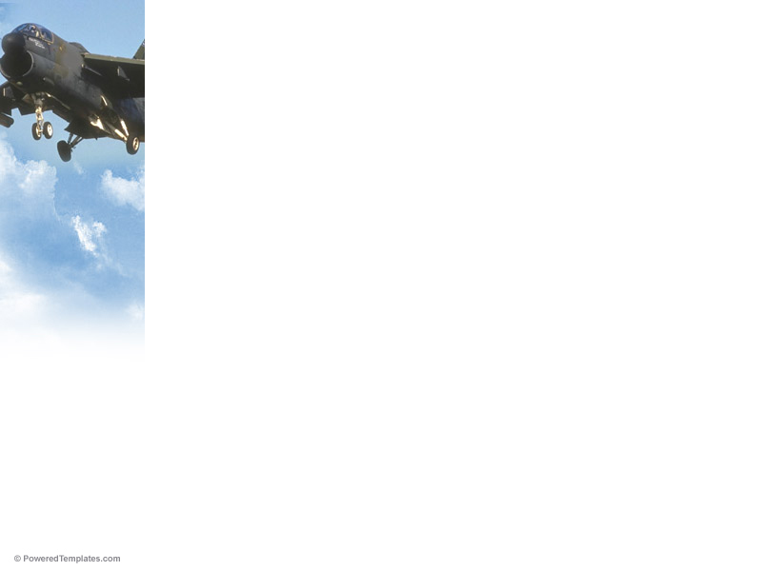
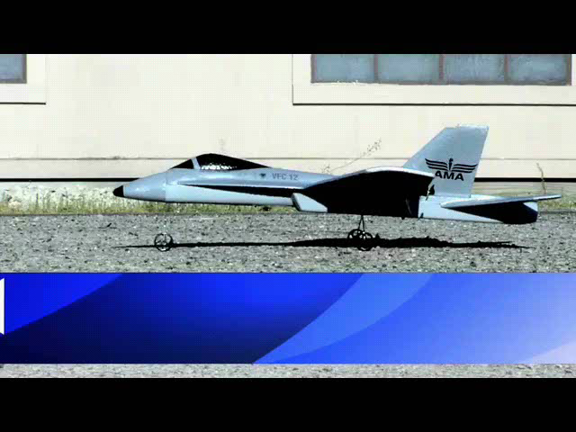

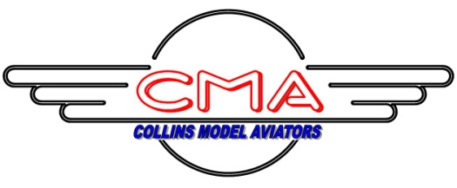
Welcome!
Notes:
Welcome message with AMA introduction clip

Slide 2
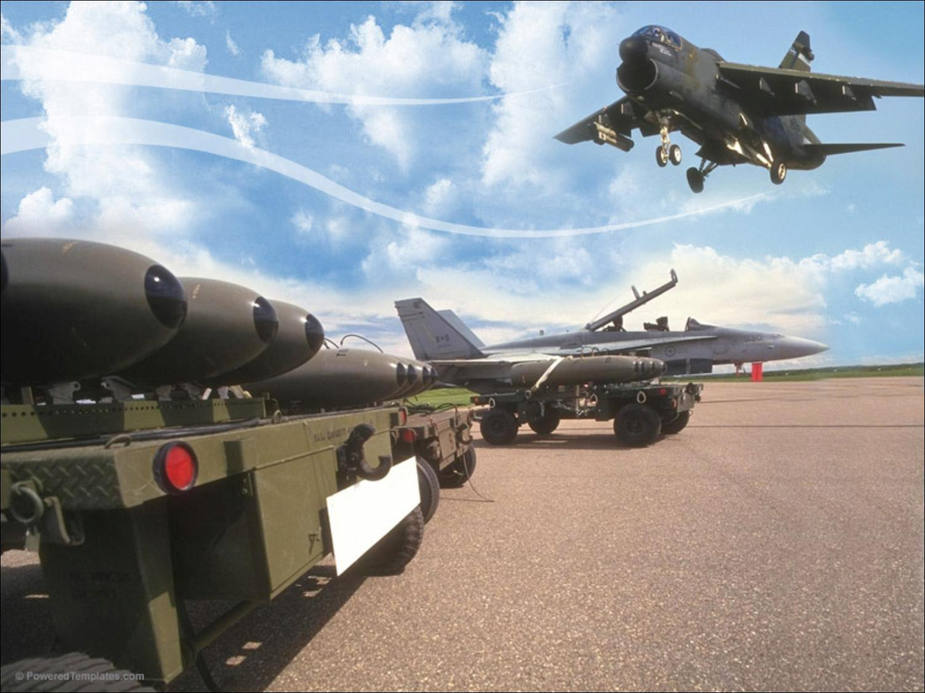

Radio Controlled Model Aircraft Flying Site Development Proposal
Collins Model Aviators

Slide 3
Purpose
To establish a working relationship to develop a site suitable for radio controlled model aircraft use.

Slide 4
Proposal
Land owned locally with oversight provided by a responsible agency.
Collins Model Aviators would be the host club, offering site owner liability insurance through their charter from the Academy of Model Aeronautics (“AMA”).
Site would be open to members of the Academy of Model Aeronautics, and members of local area clubs with current AMA membership.
Notes:
NOTE: 2.5 MILLION DOLLARS Primary insurance provide by the club to the Site Owner

Slide 5
Proposal continued
Access to the site could be controlled via issued use permits
  Yearly permits
  One-time use permits (day/weekend/other)
  Permits issued only to those holding current year AMA membership cards (proof of liability insurance)
  Permits could provide small revenue stream for ongoing maintenance of site
  Permits offer simple way to verify permission to use site/proof of liability insurance

Slide 6
Proposal continued
Collins Model Aviators would work with the governing agency to develop a site plan, based on the available land, its size, shape, and surroundings.
Collins Model Aviators would be allowed to make site improvements at their own expense (governing agency approval).
  Runway / pit area / pilot stations
  Shelter (shade/wind/sun…)
  Parking area
  Spectator area
  “Porta-Potty”
  Other

Slide 7
Proposal continued
With proper planning and execution, with support from the responsible agency and the Collins Model Aviators, the site could become a “destination” for visitors and tourists.
Long-term plans could allow the responsible agency to offer radio controlled modeling activities, in addition to the traditional soccer, baseball, football, swimming, and arts/crafts offerings.
Notes:
Might want to expound on revenues generated by visitors

Slide 8
Collins Model Aviators
Established March 1992
Academy of Model Aeronautics chartered club #3257
Sponsored by Rockwell Collins
Membership limited to –
  Employees/spouses of Rockwell Collins
  Retirees/spouses of Rockwell Collins
  Others employed by Rockwell Collins
  Those having a “reasonable” affiliation with Rockwell Collins

Slide 9
Collins Model Aviators continued
Our members build, fly, and maintain radio controlled aircraft.
  Sport aircraft
  Scale aircraft
  Helicopters
  Sailplanes
  Electric powered, “gas” powered, “glow” engine powered, un-powered
CMA offers RC pilot instruction / training
  Emphasis on SAFETY and RESPONSIBILITY
CMA members can work with schools and other community organizations to promote aviation and spark interest in science and technology education.

Slide 10
Proposed Site Plan
To be determined
The content of this slide is dependent upon the size, shape, and surroundings of the parcel of land being proposed by the city for this activity.
The slide(s) will show the land, its proposed layout and usage, and other pertinent items.

Slide 11
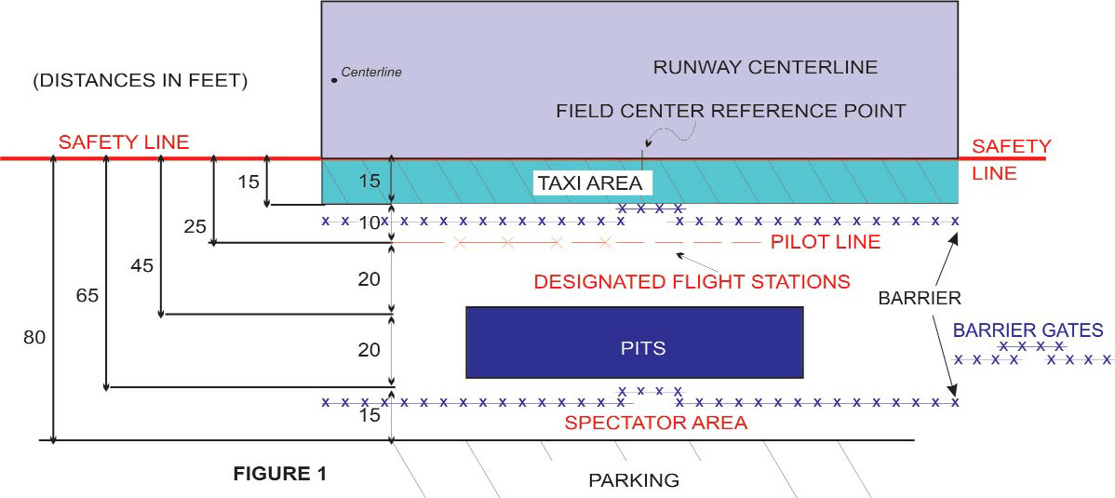
Field Operation Layout
Official AMA Safety Code is the governing factor
No landings or takeoffs from the taxi area
Barriers designed to stop taxiing models from veering into pilot or spectator positions
Pilot line set back from runway edge for safety
Public notice signs to be posted
Safety equipment available
5 acres needed for field operation

Slide 12
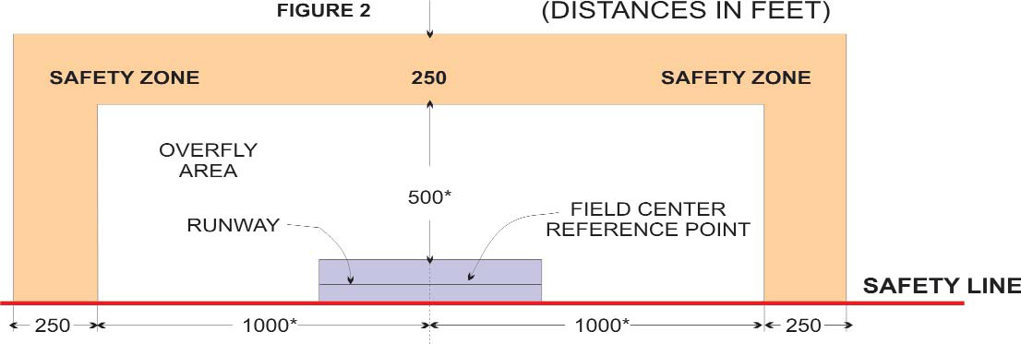
Field Flight Needs
2,000’ x 500’ Overfly Area per guidelines
Additional 250’ safety zone is desirable
Flight area clear of potential hazards
Alternate site layouts (parallel runways, cross runways, etc.) are possible.
43 acres of overfly area desired

Slide 13
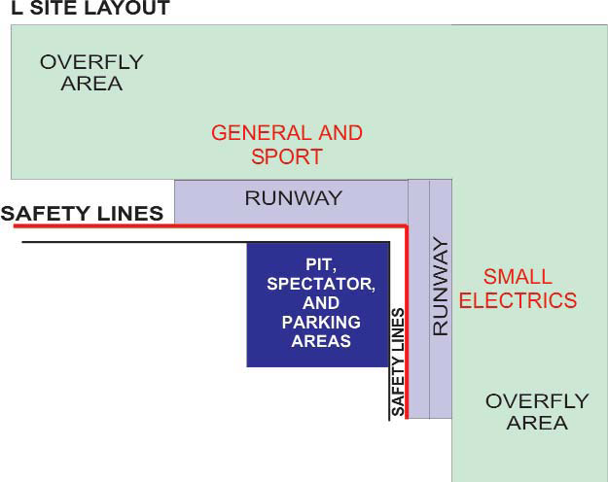
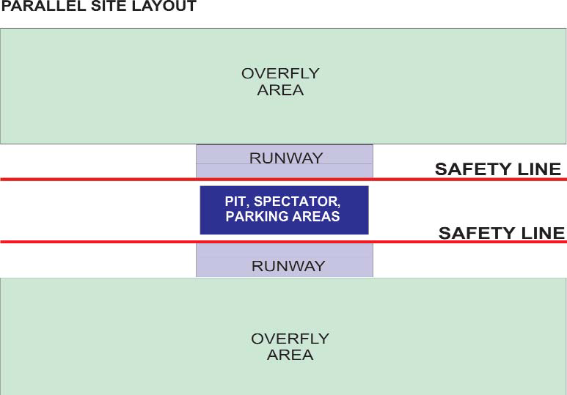
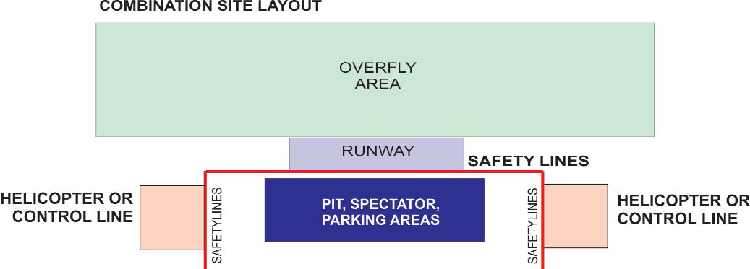
Alternative Layouts

Slide 14
Academy of Model Aeronautics
Official national body for model aviation in the United States, established in 1936
Provides membership liaison with –
  Federal Aviation Administration (FAA)
  Federal Communications Commission (FCC)
  Transportation Safety Administration (TSA)
  National, state, local governments/agencies
Provides liability insurance for –
  Flying site owners
  Chartered clubs
  Individual members

Slide 15
Additional Backup Material
Documents
  Academy of Model Aeronautics 2010 Membership Manual
    Insurance summary
    AMA Mission Statement
    2010 Safety Code
    Recommended flying site specifications
    AMA Bylaws
    Radio control operation
    Additional member information
  “What is an AMA Chartered Club?”
    “Why Should Your Group Become an AMA Chartered Club”
    “Insurance Coverage Through AMA…”
    “Comparison of Open and Park Pilot Membership Benefits”
    “Flying at AMA Chartered Club Sites”
    “Academy of Model Aeronautics Liability Insurance Program for Site Owners”
    “Park Pilot Program”
  Copy of Collins Model Aviators AMA Charter Certificate (front/back)
Documents (continued)
  Copy of Collins Model Aviators Bylaws
  Copy of Collins Model Aviators current Flying Site Rules
  Copy of Collins Model Aviators “Student Training Manual”
  Certificate of Insurance copy
  Sample “Buder Park Flying Permit” from Buder Park, Saint Louis, Missouri (front/back)
  Copy of Letter from Kansas City Radio Control Association, Describing the Permit Process employed by Jackson County, Missouri.
  Two Sample Proposals for Successful Radio Controlled Model Airplane sites, demonstrating the thought, planning, and execution typically undertaken by RC Modelers, when approaching Public Entities with site development proposals.
Audio/Visual
  DVD – “Soaring the Superfund Skies” –Environmental Protection Agency

Slide 16
Resume’s/Abstracts
David Shema
  Principal Electrical Engineer, Rockwell Collins – 13 years
  President, Collins Model Aviators – 8 years
  Past President RC Sport Flyers, Belton, Missouri – 1 year
  Past Secretary/Treasurer Bozeman Air Tragedy Society, Bozeman, Montana – 12 years
  Contest Director/Leader-Administrative and Scientific – Academy of Model Aeronautics – 25 years
  Active modeler – 45 years
  Secretary – Rockwell Collins Clubs and Leagues Board – 1 Year

Slide 17
Resume’s/Abstracts
Lloyd Swanson
  Senior Reliability, Maintainability & Safety Engineer, Rockwell Collins – 5 Years
  Secretary/Treasurer/Webmaster, Collins Model Aviators
  Past President, Belen Area Radio Controllers, Belen, New Mexico – 2 Years
  Past Field Marshal/Safety Officer, Belen Area Radio Controllers, Belen, New Mexico – 2 Years
  Administrative Leader Member – Academy of Model Aeronautics (AMA)
  Active modeler – 11 years
  Academy of Model Aeronautics All Season Flyer – 10 years
  Life Member, International Miniature Aircraft Association
  AMA District VII Associate Vice President

Slide 18
Resume’s/Abstracts
Mark Woytassek
  Principal Mechanical Engineer, Rockwell Collins – 30 Years
  Past President and Founder of Collins Model Aviators
  Academy Of Model Aeronautics - Life Member - 38 Years
  National Aeronautic Association – Member - 27 years
  National Society of Radio Controlled Aerobatics Masters class pilot
  Active modeler – 45 years

Slide 19
Resume’s/Abstracts
William Bell
  Senior Systems Engineer, Rockwell Collins – 25 Years
  Resident of Marion, Iowa – 25 Years
  Past Secretary/Treasurer, Ramstein Aero Modelers Club, Ramstein, Germany – 1 Year
  Aviation enthusiast since 1969, RC flyer since 1975

Slide 20
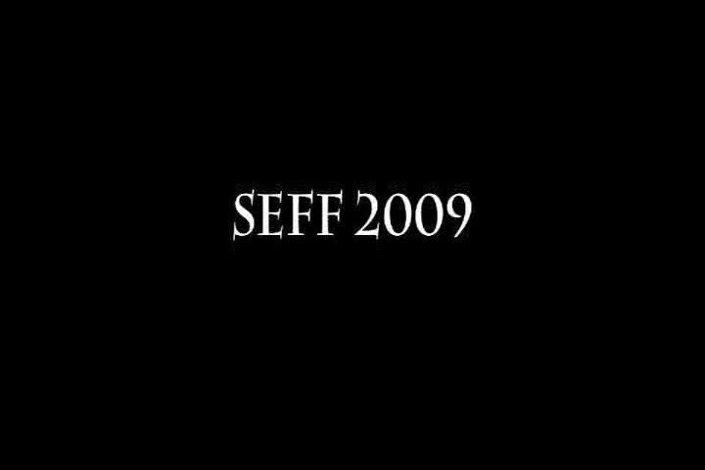
Where do we go from here?
Could this be our community?

