Slide 1
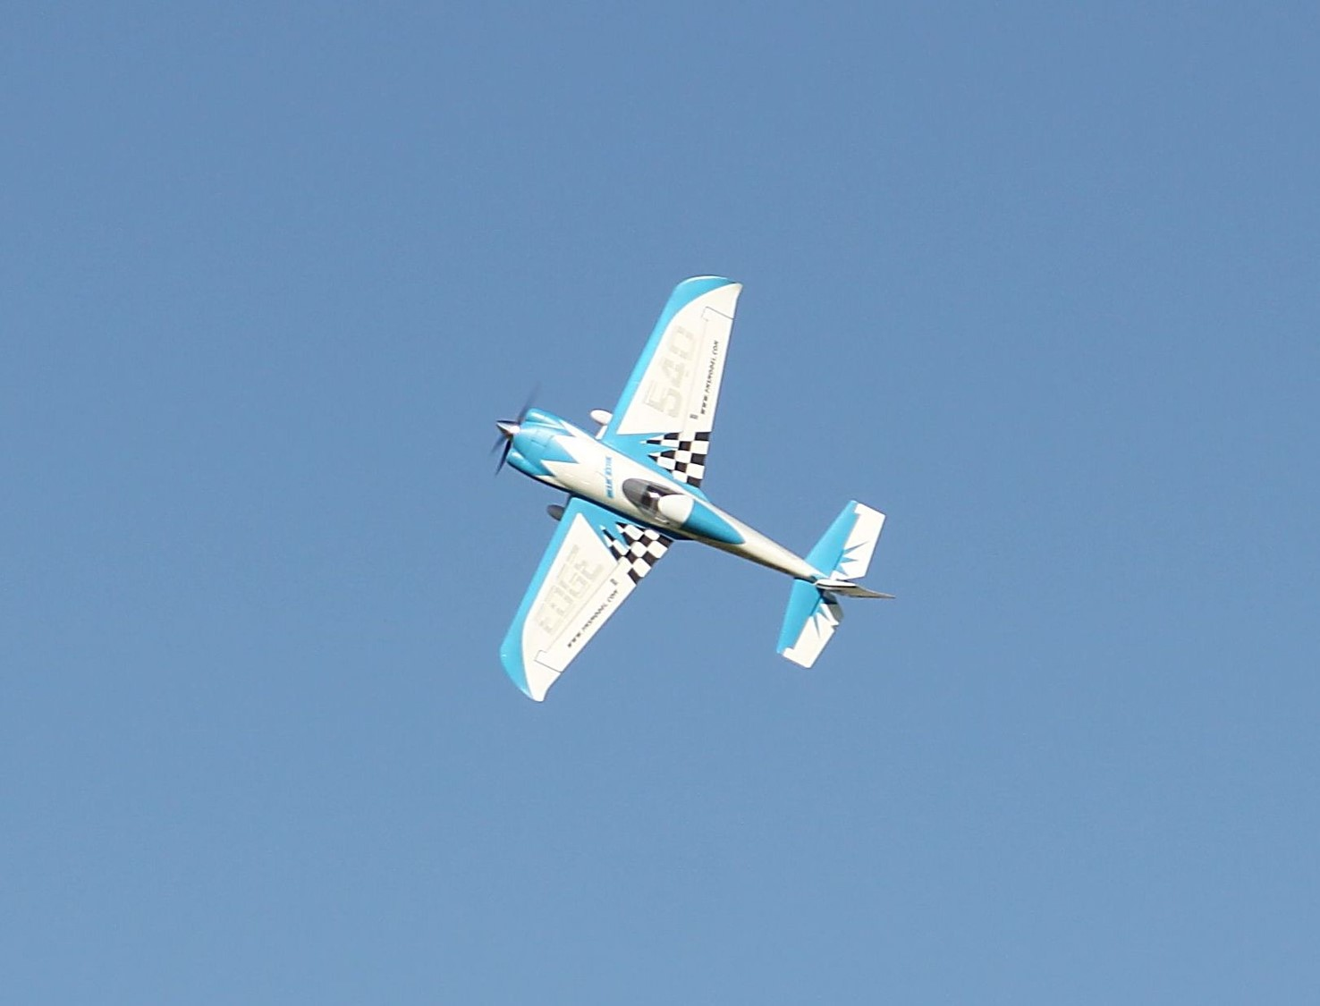
Clovis Area Modelers
Plan for an RC Park
Notes:
To use this title animation slide with a new image simply 1) move the top semi-transparent shape to the side, 2) delete placeholder image,
3) click on the picture icon to add a new picture, 4) Move semi-transparent shape back to original position, 5) Update text on slide.

Slide 2
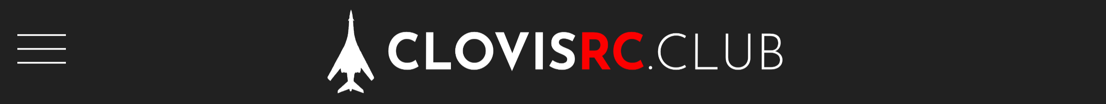
Mission Statement
We are dedicated to sharing our love of radio-controlled modeling within the community in which we live. It is our goal to provide a safe, educational, and fun venue to practice this hobby through the establishment of a local RC park.

Slide 3
"I flew in model aircraft competitions...I was an AMA member for a number of years...My model building and flying activities significantly contributed to my interest in aeronautics and was a primary force in directing my education toward aeronautical engineering."
— NASA Astronaut, Neil Armstrong

Slide 4
AMA
Academy of Model Aeronautics is the largest federally recognized association representing a membership of 195,000, chartering 2,500 model airplane clubs, and is the liaison to the FAA, FCC, and other government agencies.
Local AMA Charter
  Clovis Area Modelers has an AMA charter and 501c3 non-profit status is pending.
Fully Insured
  Clovis Area Modelers is fully insured by the AMA with a 2.5 million liability policy. The owner of any flying site we may occupy will be named on our policy.
Safety First
  Members carry proof of liability insurance and follow AMA safety guidelines.

Slide 5
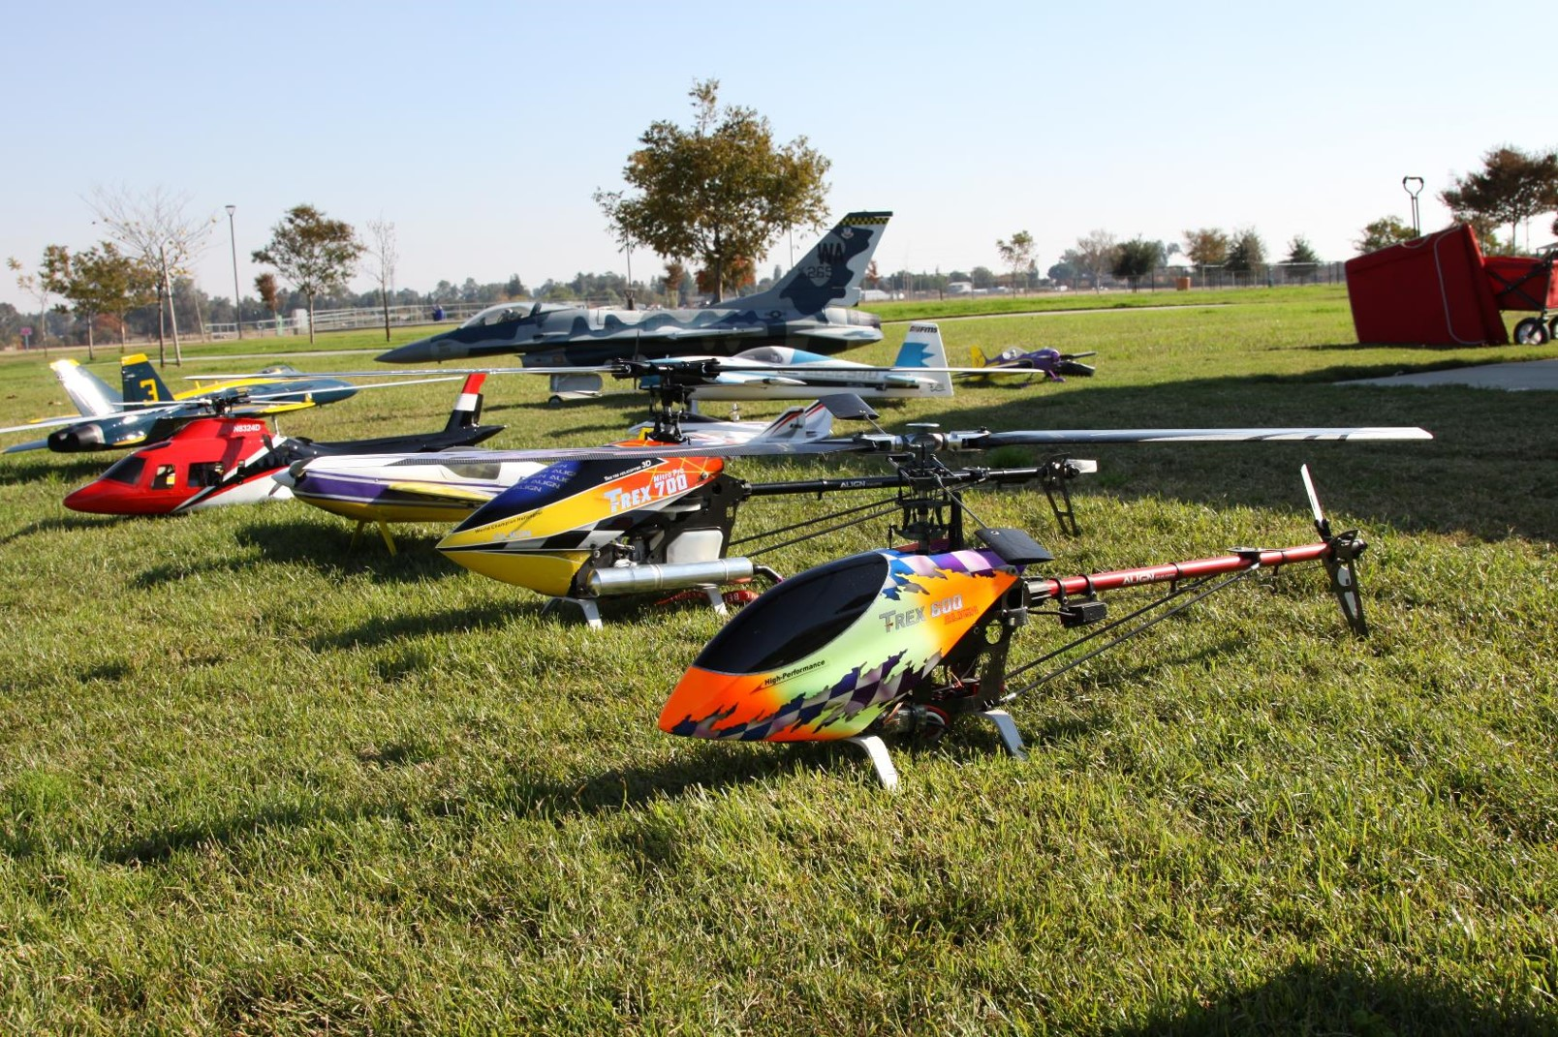
There is no venue currently within Fresno County where RC aircraft of all varieties can be legally and safely operated. In comparison, Sacramento has 6 locations and Phoenix has 17.
FACT

Slide 6
RC Club
Community Benefit
Airspace Safety
Mentoring
Educational
Career Development

Slide 7

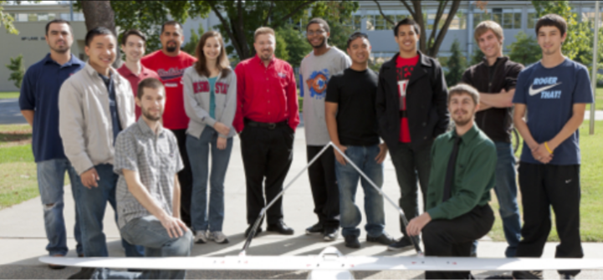
Educational
Benefits
  Imminent need for a venue nearby where schools with STEM programs (Clovis East, Duncan Polytech and Fresno State University) can engage in UAV testing related to curriculum.
Modeling encompasses sciences of aerodynamics, control systems, internal combustion engines, electric motors, robotics, and RF communication.

Slide 8
“model aviation activities is a strong driver to encourage young people to consider science and engineering as they later make their career choices. We see numerous fields for sports like baseball, football, and basketball but few for model aircraft flying. This is wrong, since there will always be more opportunities for future jobs in aviation, engineering, and science than careers in sports. A few sports heroes make a lot of money, but they are not the ones that will change our lives for the better.”
— President, Scaled Composites, Burt Rutan

Slide 9
“…any efforts that can promote interest and participation in aerospace and other engineering related projects and activities are worthy of support. Fresno State’s Lyles College of Engineering has an active research program in unmanned aerial systems. There could be future partnership between the Clovis Area Modelers and Fresno State researchers, as well.”
— Dr. Ram Nunna Ph.D, Fresno State University

Slide 10
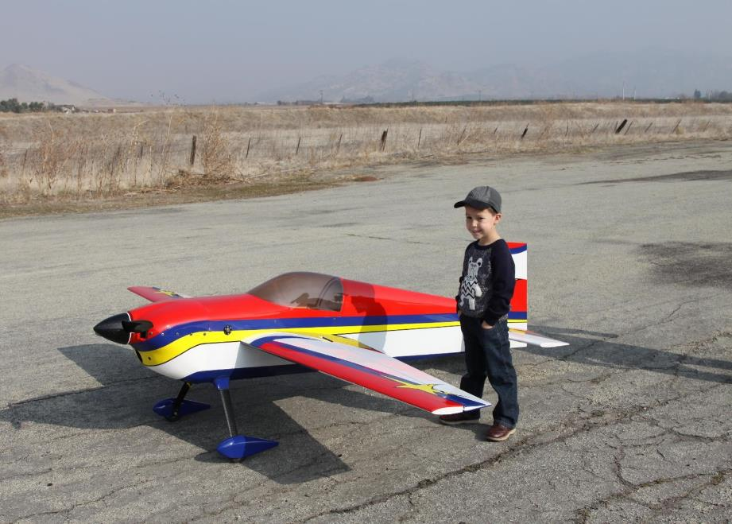
Career Development
Many pilots, military and civilian, start out as modelers in their youth.
In light of the current commercial and military pilot shortage, it would help bring interest to aviation careers.

Slide 11
“When I landed the Space Shuttle Columbia in the predawn darkness at Edwards AFB, I was performing a piloting task similar to the one the I first learned many years ago with smaller model airplanes.”
— Space Shuttle Commander Robert L. Gibson

Slide 12
"What we are missing is outdoor model flying where we can apply the physical science, meteorology and airmanship principles directly to a real 3D, non simulated environment. With the establishment of an RC Club in the area our cadets will benefit by utilizing hands-on training with actual flying models... our program will gladly support the RC Club of Clovis by integrating RC activities into our curriculum and advocating for this important Hobby. Please also note that with current Pilots shortage facing our industry, the RC Club of Clovis will do an outstanding job inspiring the next generation of Flyers to embrace the flying profession."
— USAF Col. Sam Vandiver, Senior instructor Duncan polytech Airforce ROTC

Slide 13
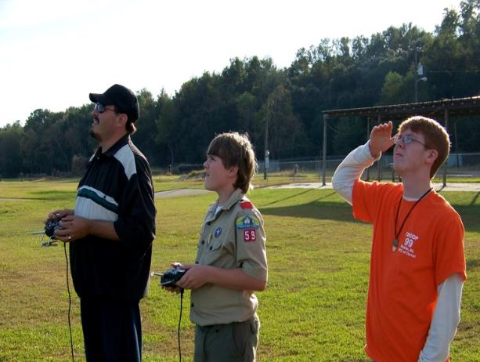
Mentoring
Radio Control modeling provides a great opportunity for the mentoring of youth. Club memberships for youth are FREE.
  We are currently establishing relationships with EAA, Boyscouts, Big Brothers Big Sisters, Boys and Girls Clubs, and Airforce ROTC programs.

Slide 14
"Clovis Area Modelers Club will be a great partner for our activities with youth. RC modeling is a great educational opportunity that can lead to important aviation and engineering related careers."
—Dianne Phakonekham MS, Executive Director
Big Brothers Big Sisters of Central California

Slide 15
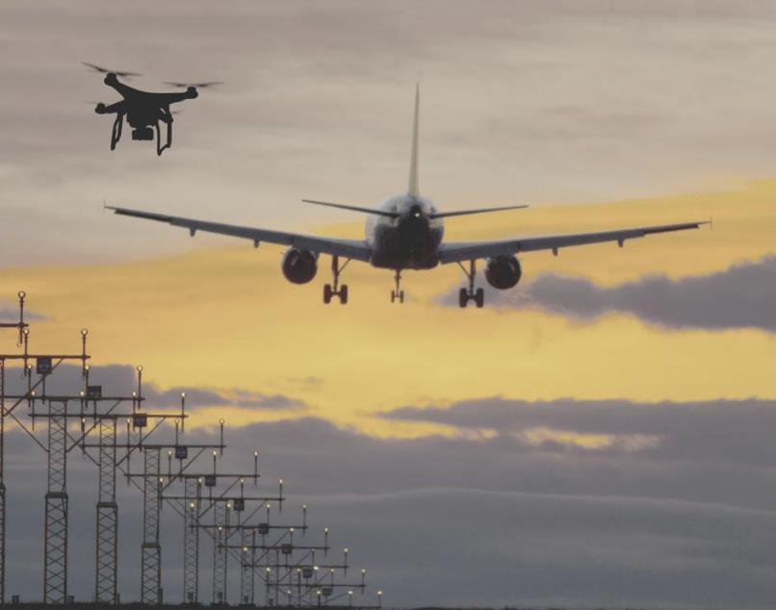
Airspace Safety
  Imminent need for a designated area for RC operations to make Fresno Air Terminal airspace safer by reducing the chance of incursions in controlled airspace
There have been multiple incursions by RC aircraft and local air traffic in recent years.
An RC Park would attract RC enthusiasts to a designated, safe area clear of other air traffic.

Slide 16
“Aerial incursions between our department’s helicopter and radio controlled aircraft is a growing concern. It is a serious safety hazard to the low flying aircraft in Fresno County. A designated area for modeling activity is a big step in the right direction. This effort is long past due…..The Sheriffs office is fully supportive of Clovis Area Modelers efforts of creating an RC park. It would be a great benefit to our county in many ways.”
— Fresno County Sheriff, Margaret Mims

Slide 17
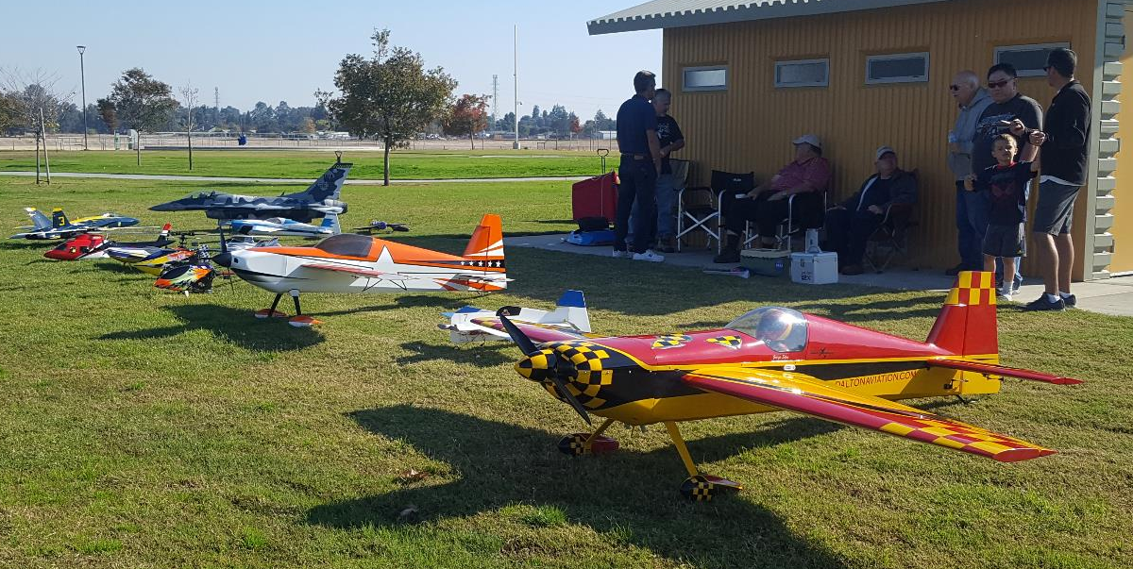
Community Benefits
Financial benefit to Clovis businesses: schools, hotels, restaurants, convenience stores would provide a venue for national and international modeling events and competitions that desire to be conveniently located in central California.
  A recreational benefit to all age groups. From children to retirees, we can all enjoy this hobby.

Slide 18
“It is an ideal pastime in which to involve today’s youth. The sport can continue, however, only as long as flying sites are available to local chapters around the country.”
— Deputy Director NASA, Captain USN James D Weatherbee

Slide 19
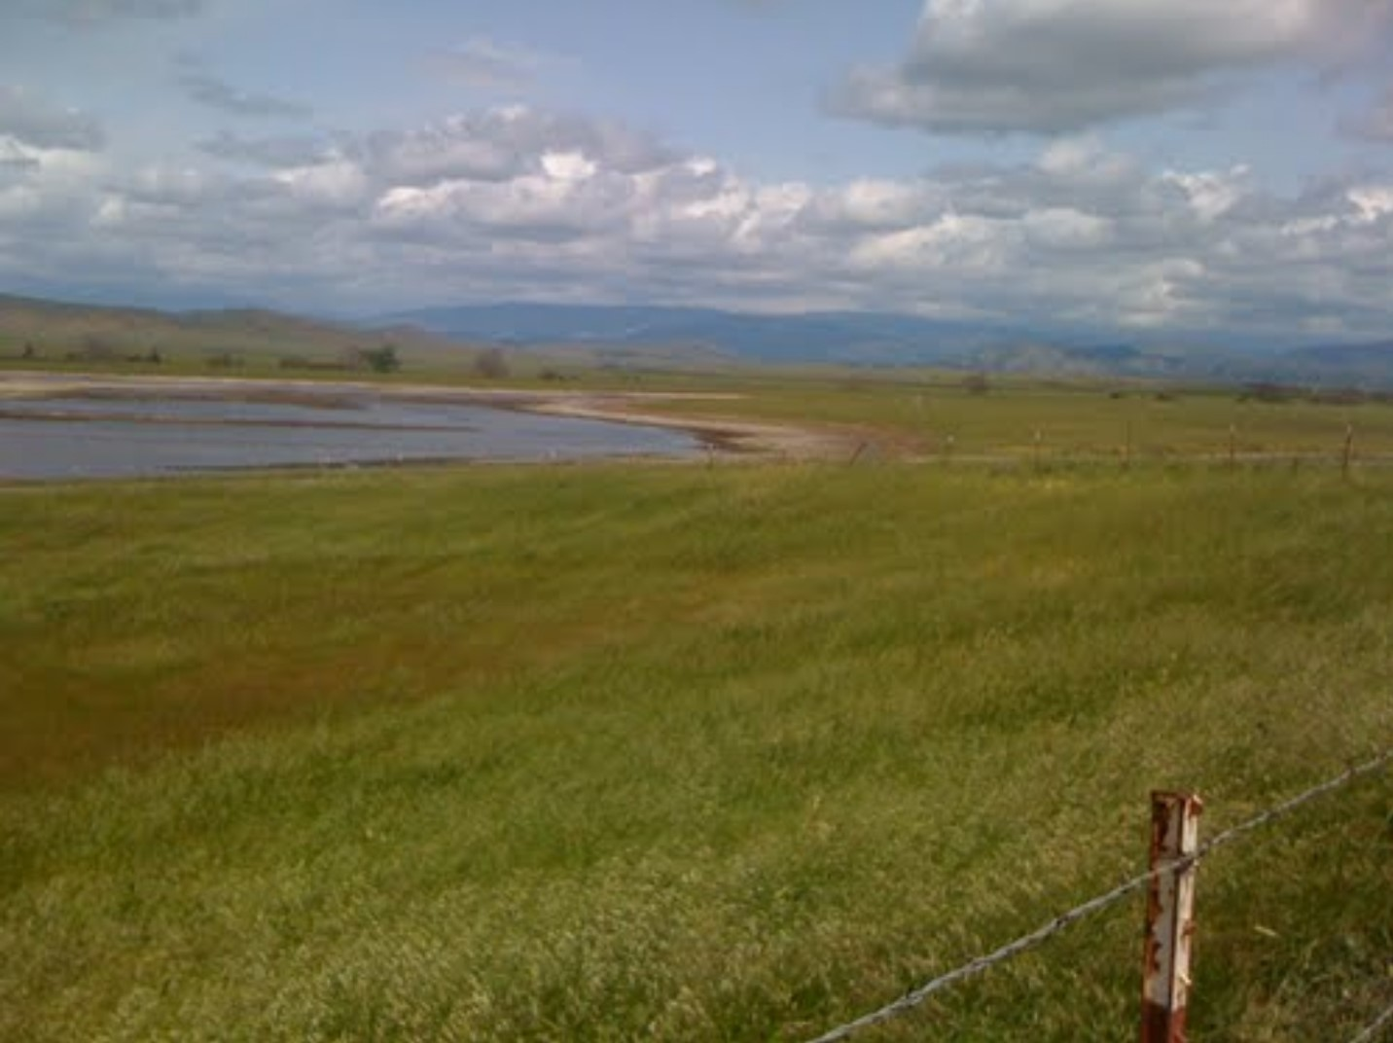
THE STAGE HAS BEEN SET
The Answer: RC Park in the Big Dry Creek Flood Plain
1
2
3
4
5
The flood plain contains over 5,000 acres of underutilized land
The RC park area of operation would encompass approx. 20 acres
Already designated as a future regional park in Clovis general plan
Many other parks have been located in flood plains
Noise will never be a factor in this area.

Slide 20
(14) RC Clubs located in a Flood Plain
FACT
Bartlesville Falcons Model Club | Independence | KS
BEAUMONT RADIO CONTROL CLUB | BEAUMONT | TX
BRCA | Bellevue | NE
Broken Arrow Rotors | Tulsa | OK
Camarillo Flying Circus | Oxnard | CA
CHULA VISTA MODEL & RC CLUB | Imperial Beach | CA
Hampshire County Radio Controllers | South Deerfield | MA
Joliet Radio Control Club | Minooka | IL
Midwest Air Wing R/C Club Inc. | Edwardsville | IL
North Dallas RC Club NDRCC | Plano | TX
OKC RC FLYERS | Edmond | OK
Rockvalley R/C Flyers | Roscoe | IL
Society of Antique Modelers Chapter 7 | West Haven | CT
San Fernando Valley Flyers | Los Angeles | CA
D AD AD A
AD A

Slide 21
Letters of Support - Local
William Campbell, President Experimental Aircraft Association Chapter 376
John Richers, CEO and Scout Executive Boy Scouts Of America Sequoia Council
Scott Florer, President Allen-Florer Family Homes
Dennis Nodine, CMSgt (Ret) USAF, Air Force ROTC Clovis East High School
Bob Specht, Director Veterans Memorial Museum
Tyler Dobbs, Government Affairs /Public Relations Academy of Model Aeronautics
Ram Nunna,Ph.D, Dean, Lyles College of Engineering CSUF
Rudy W. Cardona, Lt Col, USAF (Ret.) Director Aerospace Science Department
Sam Vandiver Senior Col, USAF (Ret.) Senior Aerospace Science Instructor DPHS
Mark L.Taylor, Maj.(Ret) USAF
Dianne Phakonekham,MS, Executive Director Big Brothers Big Sisters of Central CA
Margaret Mims, Sheriff-Coroner, Fresno County Sheriff’s Office

Slide 22
Letters of Support - National
Norman Y. Mineta, Chairman Subcommittee on Aviation
Verne Orr, Secretary of the U.S.A.F.
J. R. Ryan, Vice Admiral, USN, Superintendent
Neil Armstrong, Astronaut
Frank Borman, Astronaut
Robert Gibson, USN, Commander Shuttle Mission 41-B, Shuttle Mission 61-C
C. D. Dean, Lieutenant General, USMC
James D. Weatherbee, Captain, USN, Deputy Director, NASA
Bert Rutan, President and CEO of Scaled Composites
T. Allan McArtor, FAA Administrator
Derrick A. Crandall, President American Recreation Coalition

Slide 23
Guests – Q&A
THANK YOU

